Slide 1




Slide 2

MINIMUM STACK

Slide 4
MINIMUM STACK
EXPLANATION
A stack is a type of data structure where items are added and removed from the top of the stack according to the Last-In-First-Out (LIFO) principle.
Finding the smallest element poses challenges as the stack does not naturally allow direct access to it, but gaining access to and deleting elements from the top of the stack is simple.

Slide 5
MINIMUM STACK
OPERATIONS
Push
Pop
Top
Getmin

Slide 6
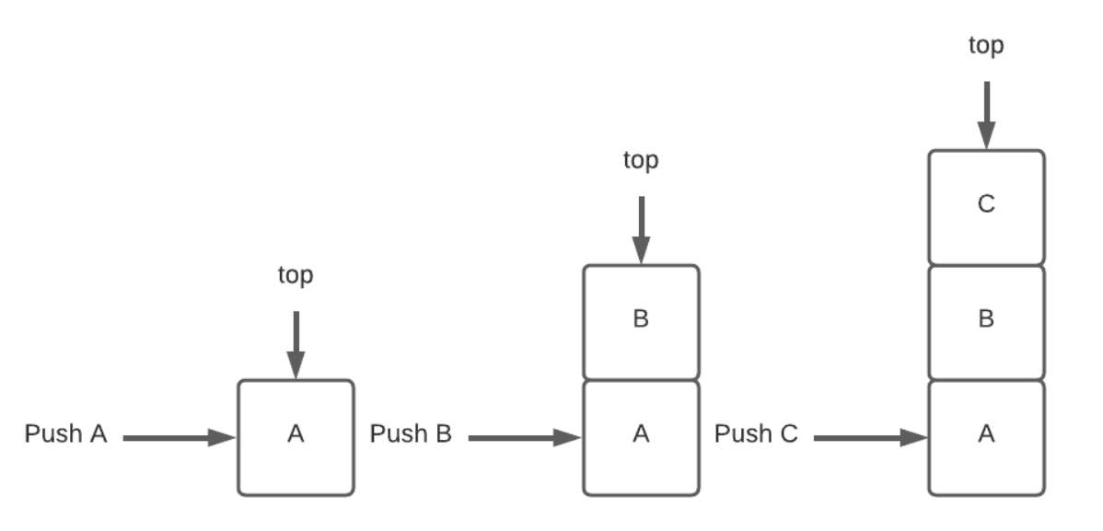
MINIMUM STACK
1.PUSH
Push an element into the stack by performing this action. The element is added, or "pushed," to the top of the stack, and the sizeof the stack is increased by one as a result.

Slide 7
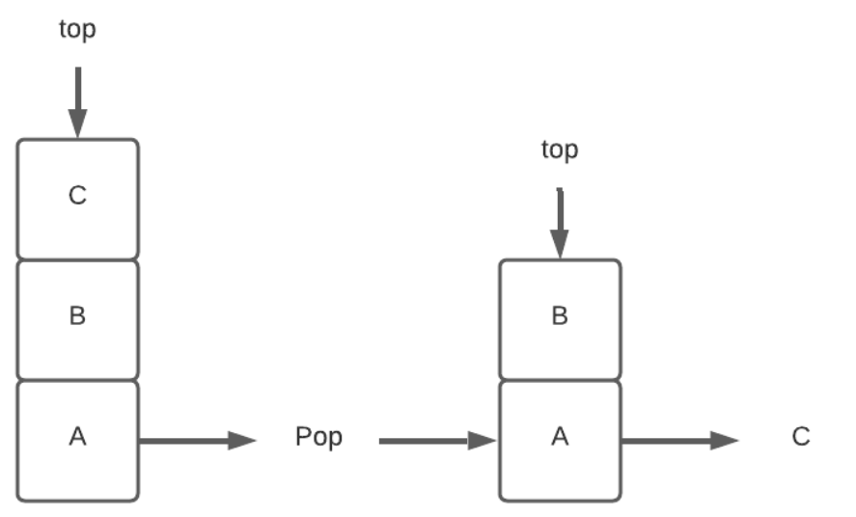
MINIMUM STACK
2.POP
Stack operation performed to remove an element from the stack. The element is removed, or popped from the top

Slide 8
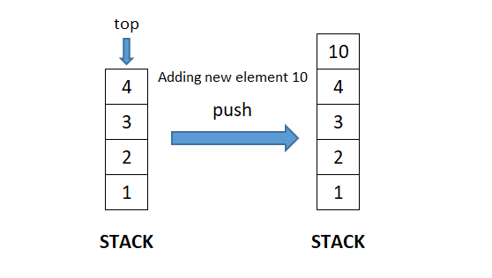
MINIMUM STACK
3.TOP
Stack operation to get the element stored at the top of the stack. The element is not removed using this stack operation.

Slide 9
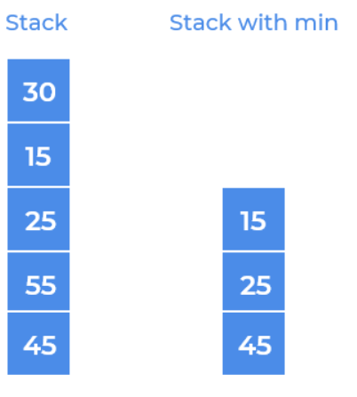
MINIMUM STACK
4.GETMIN()
Retrieve the minimum element in the stack.

Slide 10
MINIMUM STACK
ALGORITHM
Initialize two stacks: a main stack to store elements and a minimum stack to track the minimum elements.
During the push operation:
Push the new element onto the main stack.
Compare the new element with the top element of the minimum stack:
If the new element is smaller or equal, push it onto the minimum stack.
Otherwise, push the current top element of the minimum stack onto itself.

Slide 11
MINIMUM STACK
ALGORITHM
During the pop operation:
Pop the top element from both the main stack and the minimum stack.
6. To retrieve the minimum element, simply peek at the top of the minimum stack.

Slide 12
MINIMUM STACK
PSEUDOCODE
Initialize mainStack and minStack
Push(element):
Push element onto mainStack
If minStack is empty OR element <= top(minStack):
Push element onto minStack
Pop():
If top(mainStack) == top(minStack):
Pop from minStack
Pop from mainStack
GetMin():
Return top(minStack)

Slide 13
MINIMUM STACK
SAMPLE PROGRAM 1
INPUT
stack.push(5);
stack.push(2);
stack.push(7);
stack.push(1);
int minElement = stack.getMin();
stack.pop();
int topElement = stack.top();
int newMinElement = stack.getMin();

Slide 14
MINIMUM STACK
SAMPLE PROGRAM 1
OUTPUT
Minimum Element: 1
Top Element: 7
After Pop New Minimum Element: 2

Slide 15
MINIMUM STACK
import java.util.Stack; class MinStack { Stack<Integer> stack; // Stack to store elements Stack<Integer> minStack; // Stack to track minimum elements public MinStack() { stack = new Stack<>(); minStack = new Stack<>(); } public void push(int element) { stack.push(element); // Push the element onto the main stack // Update the minimum stack if (minStack.isEmpty() || element <= minStack.peek()) { minStack.push(element); // Push the element onto the minimum stack } } | import java.util.Stack; class MinStack { Stack<Integer> stack; // Stack to store elements Stack<Integer> minStack; // Stack to track minimum elements public MinStack() { stack = new Stack<>(); minStack = new Stack<>(); } public void push(int element) { stack.push(element); // Push the element onto the main stack // Update the minimum stack if (minStack.isEmpty() || element <= minStack.peek()) { minStack.push(element); // Push the element onto the minimum stack } }

Slide 16
MINIMUM STACK
public int getMin() { if (!minStack.isEmpty()) { return minStack.peek(); // Return the minimum element from the minimum stack } // Stack is empty, return -1 or throw an exception as desired return -1; } public static void main(String[] args) { MinStack stack = new MinStack(); // Push some elements onto the stack stack.push(5); stack.push(2); stack.push(7); stack.push(1); | // Retrieve and print the minimum element int minElement = stack.getMin(); System.out.println("Minimum Element: " + minElement); // Output: Minimum Element: 1 // Pop an element from the stack stack.pop(); // Retrieve and print the top element int topElement = stack.top(); System.out.println("Top Element: " + topElement); // Output: Top Element: 7 // After pop int newMinElement = stack.getMin(); System.out.println("After Pop New Minimum Element: " + newMinElement); } }

Slide 17
MINIMUM STACK
SAMPLE PROGRAM 1
Input
["push","push","pop","push","push“,”peek”,"push","getMin","pop","getMin"]
[ [2 ], [3], [ ], [4], [ -1], [ ], [6], [ ], [ ], [ ] ]
Output
[-1]

Slide 18
MINIMUM STACK
SAMPLE PROGRAM 1
Explanation
MinStack minStack = new MinStack();
minStack.push(2);
minStack.push(3);
minStack.pop();
minStack.push(4);
minStack.push(-1);
minStack.peek();
minStack.push(6);
minStack.getMin(); // return -1
minStack.pop();
minStack.getMin(); // return -1

Slide 19
MINIMUM STACK
import java.util.Stack; //class class MinStack { private Stack<Integer> stack; private Stack<Integer> minStack; //constructor –memory creation public MinStack() { stack = new Stack<>(); minStack = new Stack<>(); } public void push(int val) { stack.push(val); if (minStack.isEmpty() || val <= minStack.peek()) { //or opreration for check any one is true minStack.push(val); } } | public void pop() { if (!stack.isEmpty()) { if (stack.peek().equals(minStack.peek())) { minStack.pop(); } stack.pop(); } } public int top() { return stack.peek(); } public int getMin() { return minStack.peek(); } }

Slide 20
MINIMUM STACK
public class Main { public static void main(String[] args) { MinStack minStack = new MinStack(); minStack.push(2); minStack.push(3); minStack.pop(); minStack.push(4); minStack.push(-1); minStack.top(); minStack.push(6); minStack.getMin(); minStack.pop(); minStack.getMin(); System.out.println("Current Min: " + minStack.getMin()); } }

Slide 21
MINIMUM STACK
TIME COMPLEXITY AND SPACE COMPLEXITY
The time and space complexity of this code is O(1) for each of the push, pop, top, and getMin operations because the code's execution time and memory usage do not depend on the number of elements in the stack.

Slide 22
MINIMUM STACK
public class Main { public static void main(String[] args) { LinkedList list = new LinkedList(); list.append(1); list.append(2); list.append(3); list.append(4); list.append(5); System.out.println("Original list:"); list.printList(); list.segregateEvenOdd(); System.out.println("Segregated list (even before odd):"); list.printList(); } }

Slide 23
MINIMUM STACK
Time complexity and space complexity
Time complexity: O(N), where N is the number of nodes in the linked list.
Space complexity: O(1), constant space is used for the pointers and temporary variables.

Slide 24
INTERVIEW QUESTIONS
1. Why is it necessary to use an additional stack for retrieving the minimum element?
Answer: The additional stack, known as the min stack, is used to keep track of the minimum element at each point in the main stack. It ensures constant-time retrieval of the minimum element without having to traverse the entire stack every time. This approach improves efficiency and maintains the LIFO property of the stack.

Slide 25
INTERVIEW QUESTIONS
2. What is the time complexity of retrieving the minimum element from the stack using the Min Stack approach?
Answer: The time complexity to retrieve the minimum element using the Min Stack approach is constant, O(1). Since the minimum element is always stored at the top of the min stack, accessing it does not depend on the size of the main stack.

Slide 26
INTERVIEW QUESTIONS
3. Does using the Min Stack approach increase the space complexity?
Answer: Yes, using the Min Stack approach increases the space complexity. In addition to the main stack, an extra stack (the min stack) is required to store the minimum elements. However, the space complexity remains proportional to the number of elements in the stack.

Slide 27
INTERVIEW QUESTIONS
4. How does the Min Stack approach handle scenarios when the minimum element is popped from the main stack?
Answer: When the minimum element is popped from the main stack, the Min Stack approach ensures consistency by also popping the corresponding minimum element from the min stack. This guarantees that the top of the min stack always represents the minimum element present in the main stack at any given time.

Slide 28
INTERVIEW QUESTIONS
5. Can the Min Stack approach be used with any type of stack implementation?
Answer: Yes, the Min Stack approach can be used with any type of stack implementation, whether it’s implemented using an array or a linked list. The key idea is to maintain a separate stack for tracking the minimum elements alongside the main stack.

Slide 29

https://learn.codemithra.com

Slide 30




THANK YOU
+91 78150 95095
codemithra@ethnus.com
www.codemithra.com

